Slide 1
WeBWorK Demonstration Workshop
MCTM Annual Meeting
Starkville, MS
September 14, 2012
John Travis – Mississippi College
and Ravinder Kumar – Tougaloo College
Notes:
John Travis introduce Ravinder and welcome everyone to the workshop.

Slide 2
WeBWorK Demonstration Workshop
These slides and links to all materials are available at
http://math.mc.edu/travis
Notes:
Remind that this presentation and other links available at this site.
Announce that the address will be made available again at the end of the workshop and that the address is available on the printout.

Slide 3
Workshop Overview
Introduction to WeBWorK – 10 minutes
Connections to Common Core
The student interface – 30 minutes
Course Demonstrations
The instructor interface – 30 minutes
The Problem Library
Creating homework problems sets
Reviewing Student Statistics
Administering a WeBWorK course
Hosting WeBWorK or using MAA hosting – 5 minutes
Discussion about future possible training sessions
Summer week-long workshop in Clinton?
Names/email addresses?
Notes:
We will hope to be through with the main part in an hour or so…unless things go long!
Plans are to have plenty of time for questions/answers at the end as well as time to experiment.
Please sign the sheet going around.

Slide 4
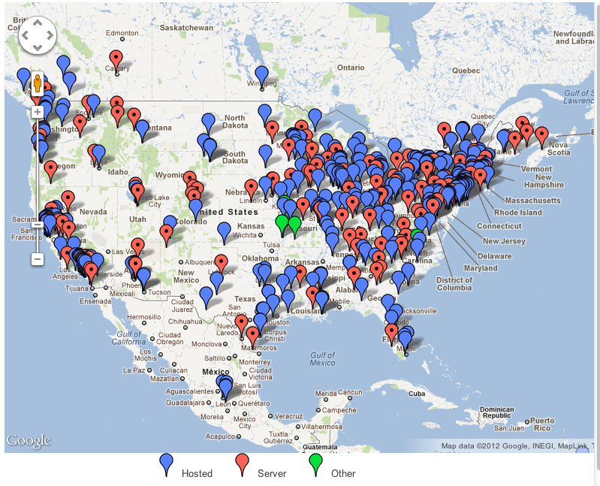
What is this about FREELY AVAILABLE online homework?
Can something free be
good?
http://webwork.maa.org/wiki/WeBWorK_Sites
Notes:
Over 500 institutions including several high schools
In Mississippi: Mississippi College, Jackson State, Alcorn State, Tougaloo College
Louisiana: LSU, LaTech, Southeastern
Alabama: University of Alabama, Birmingham-Southern

Slide 5
What is this about online homework?
Effective and efficient:
It increases the effectiveness of traditional homework as a learning tool by:
Providing students with immediate feedback on the validity of their answers and giving students the opportunity to correct mistakes while they are still thinking about the problem.
Providing students with individualized versions of problems which means that instructors can encourage students to work together.

Slide 6
What is this about online homework?
Effective and efficient:
It increases the efficiency of traditional homework by:
Providing automatic grading of assignments
Providing information on the performance of individual students and the course as a whole
Notes:
How many currently use online homework?
What systems? What cost?
How do you feel that it works?

Slide 7
What is this about online homework?
Common Core Connections:
WeBWork is already in line with CCSS since it forces students to read in the content area to work the problems. Reading literacy is a big part of CCSS so the fact that students have to work the problems and read what is asked for is in line with this requirement.
WeBWork is a system to help teachers roll out CCSSs by providing a system where students can practice math problems as homework while providing more time for teachers to spend with higher level critical thinking in the classroom.
Notes:
Of course specific mathematics topics in Common Core can be addressed using specific problems from the Library of Problems

Slide 8
What is this about online homework?
Common Core Connections :
Precollege content that WeBWork can target include:
PreAlgebra (currently being developed)
Algebra II
Pre-Calculus
College Algebra
Trigonometry
AP Calculus
AP Statistics
Notes:
Generally the more advanced courses have larger problem collections since WeBWorK was originally intended for collegiate use and by collegiate professors.

Slide 9
Using student interface
If you have an internet capable device, you are welcome to follow along live…as a student!
Mississippi College server:
http://math.mc.edu/webwork2/
Choose a course from the list
Login: choose a Guest Account if one exists
Password: unnecessary for a Guest Account
You are welcome to request an official login so that you can review your past answers…travis@mc.edu
Notes:
Email travis if you would like an account on any of these courses.

Slide 10
Using student interface
If your device cannot connect to the internet through the conference center or via your cellular plan…
Local Area Broadcast:
Connect to wifi network testwww
Browse to http://192.168.1.2/webwork2/
Pick a unique course starting with 101 (shout out your #)
Login: jdoe (or jsmith)
Password: jdoe (or jsmith)
Everything is case sensitive so no capitals please!
Notes:
Use this slide only if necessary and only if the external wireless options all fail.

Slide 11
Using student interface
An option for later…
Mathematical Association of America server:
http://test.webwork.maa.org/webwork2/
Login: studenta (or studentb)
Password: profa (or profb)
Available courses include:
maa101 , maa102 , maa102_spanish , maa103
maa103_french , maa104_english , maa110_turkish
(Note that if someone else logs in using these accounts while you are logged in, you will get booted off!)
Notes:
Use this one later if desired to check something out.

Slide 12
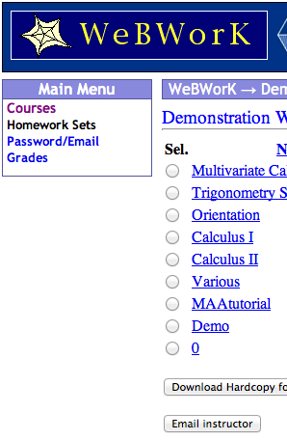
Using student interface
Changing Password
Checking Progress
Doing Homework Sets

Slide 13
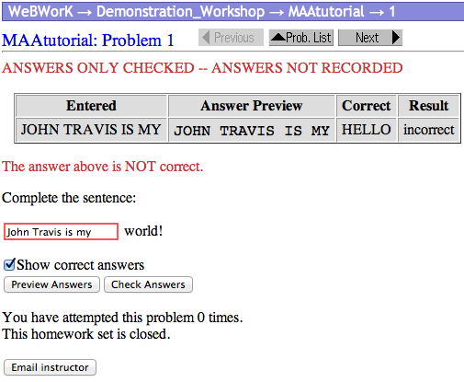
Using student interface
Open a pre-algebra problem set
Try a few problems
Email Instructor option
Notes:
Have a few participants do the Email instructor option and then show them the result.

Slide 14
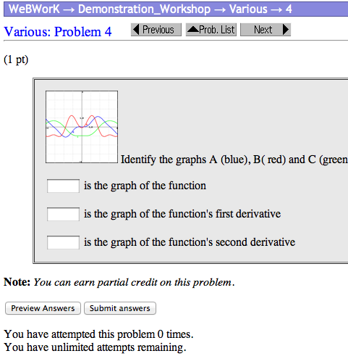
Using student interface
PreAlgebraHomework Sets
http://http://math.mc.edu/webwork2/PreAlgebra/
See what happens IF you miss some answers.
Download Hardcopy option
Notes:
Comment: Students use the hardcopy option to work offline. Good if they want to bring online homework by office.
Students will bring laptop to office as well.
Currently an iOS app version of WebWork is in development.

Slide 15
Using student interface
Calculus Homework Sets
http://math.mc.edu/webwork2/Tougaloo-222/
Notes:
Comment: Students use the hardcopy option to work offline. Good if they want to bring online homework by office.
Students will bring laptop to office as well.
Currently an iOS app version of WebWork is in development.

Slide 16
Using student interface
Trig Homework Sets
http://math.mc.edu/102/
Notes:
Comment: Students use the hardcopy option to work offline. Good if they want to bring online homework by office.
Students will bring laptop to office as well.
Currently an iOS app version of WebWork is in development.

Slide 17
Using student interface
Statistics Homework Sets
http://math.mc.edu/webwork2/353/
Notes:
Comment: Students use the hardcopy option to work offline. Good if they want to bring online homework by office.
Students will bring laptop to office as well.
Currently an iOS app version of WebWork is in development.

Slide 18
Using instructor interface
Accounts can be given increasingly greater privilege
Guest – look but no answers
Student – answers checked and graded
Proctor – administer gateway (proctored) exams
TA – access Instructor Tools and receive feedback
Professor – modifying everything
http://webwork.maa.org/wiki/Permissions

Slide 19
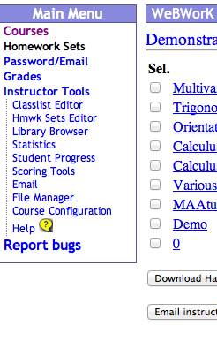
Using instructor interface
Let’s look at an account via the instructor/professor level.
Notes:
Change one person and see if they can change another person’s login. Chain along.

Slide 20
Using instructor interface
Notice the additional options
Experiment:
Classlist Editor
Statistics
Student Progress
Notes:
Switch over to a live class from this semester and show the statistics for a real class

Slide 21
Using instructor interface
Experiment:
Email
File Manager
Course Configuration
“Instructor Tools” – one stop shopping
Notes:
Send out an email to the entire class
Note the different styles that are available.

Slide 22
The Problem library
WeBWorK can handle:
Numbers (of course)
Formulas
Lists
Drop-down menus
Multiple choice
Multi-part problems
Proper units
HTML links
Video
Sage and other interactive content
Lots more…
http://webwork.maa.org/wiki/Category:Problem_Techniques

Slide 23
The Problem library
WeBWorK can handle:
Varying problem styles
Smart answer checking
Hints and solutions

Slide 24
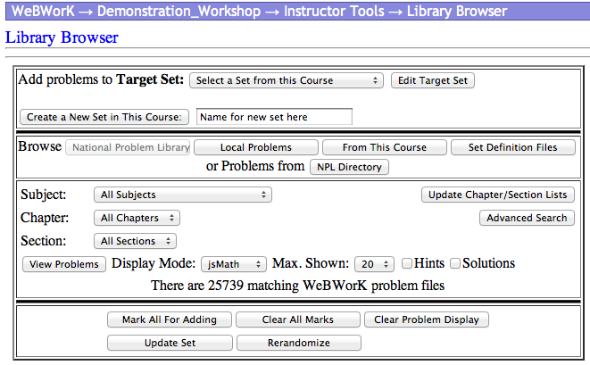
The Problem library and creating homework sets
Create Set
Search by drop box
Advanced Search
Local problems
Create a set and select problems.

Slide 25
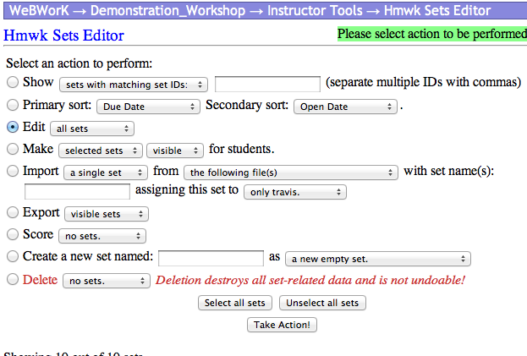
Assigning homework sets
Editing individual sets
Editing all sets
Making visible
Assigning to students
Setting dates

Slide 26
Administering WeBWorK
Allowing unsaved Guest accounts
Adding/dropping students
Changing passwords
Setting special due dates for individual students
Instructors can also create interesting problem set headers and course headers…

Slide 27
Online Hosting
Hosted at MAA
Easiest and a good way to start
Send a request to webwork@maa.org
They are responsible for backups, upgrades, etc.
Set up your own WeBWorK system
More complicated
You need a server
You are responsible for backups, upgrades, etc.
Mississippi College
Contact John Travis (travis@mc.edu) regarding settup up a course so that you can try things out.

Slide 28
Using MAA hosting service
Free turnkey trials are available through the MAA for users who want to try out WeBWorK
Maximum of 100 students per institution
Maximum 12 months
One-time offer only
Long term hosting options exist
MAA Departmental Members $200 (6-month plan)
Non-members $300 (6-month plan)
http://webwork.maa.org/faq.html#hosting

Slide 29
Hosting WeBWorK
WeBWorK is open source and freely available for users who want to download, install and maintain their own system.
Complete instructions are available on the wiki
http://webwork.maa.org/wiki/Installation_Manual_for_2.4
Online forums are available for help
http://webwork.maa.org/moodle/mod/forum/index.php?id=3
Nearby institutions might agree to host relatively small classes to help you get started.

Slide 30
Assessing WeBWorK’s impact
On Teaching
On Learning
http://webwork.maa.org/moodle/course/view.php?id=5
Please fill out the workshop evaluation forms…

Slide 31
Thanks! webwork.maa.org
Questions: travis@mc.edu or ravinder.rkumar@gmail.com
Slides available at
http://math.mc.edu/travis

